Slide 1

TECH AVENGERS
TEAM LEAD
Sahil Jain (CSE 1-year, MITS-DU)
Email – jainsahil022@gmail.com

Slide 2
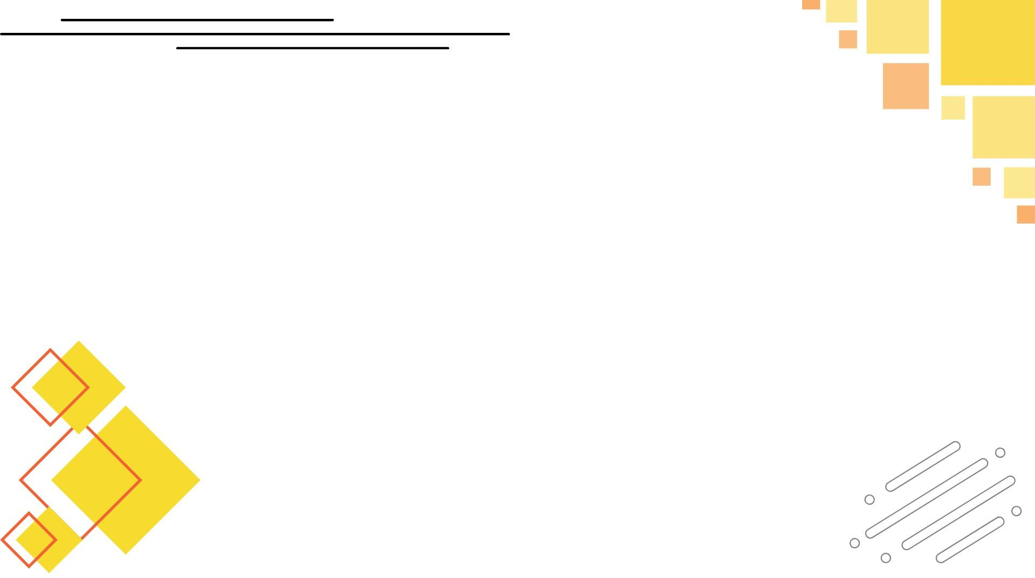
PROBLEM STATEMENT
1. AI Symptom Checker: Build a virtual assistant for symptom analysis, triage, and doctor recommendations.
2. Predictive Patient Risk Models: Develop tools to forecast hospital readmissions and calculate patient risk scores.
3. Automated Clinical Documentation: Use voice recognition and NLP to generate accurate clinical notes automatically.
There is no unified, intelligent system that helps both patients and doctors navigate early-stage symptom analysis, real-time risk assessment and automated clinical documentatioall in an accessible, ai-powered platform.
CHALLENGES | DETAILS
Fragmented patient journey | Patients lack unified access to symptom triage, risk assessment, and doctor interaction.
Manual clinical workflows | Doctors spend significant time writing and updating patient notes manually.
Delayed risk identification | Hospitals lack real-time risk scoring and alerts for patient deterioration.
Lack of AI explainability | Existing tools provide predictions without showing the reasoning (black box).
Accessibility in remote areas | No mobile-first AI platform that supports patients in rural or underserved regions.

Slide 3
PROPOSED SOLUTION
AI-Based Health Care Navigator : HealthBro
HealthBro is a cross-platform, AI-powered health assistant that enables early symptom triage, real-time patient risk prediction, and automated clinical documentation using voice and NLP. Built with Flutter, Firebase, and FastAPI, it empowers both patients and doctors with intelligent, accessible, and explainable healthcare tools.
SOLUTIONS OF THE PROPOSED PROBLEMS
UNIFIED AI CARE ASSISTANT | Combines symptom checker, risk scoring, and clinical note generation in one platform.
AI-POWERED SYMPTOM TRIAGE | Uses NLP to analyze patient symptoms and recommend triage level + department.
ML-BASED RISK PREDICTION | Calculates patient readmission or deterioration risk using vitals and medical history.
VOICE-TO-NOTE AUTOMATION | Uses Whisper + spaCy to convert doctor voice input into structured clinical notes.
SHAP EXPLAINABILITY | Provides interpretable AI predictions showing top contributing features.
CROSS-PLATFORM (WEB + MOBILE) | Built with Next.js and Flutter for accessibility on desktop and mobile devices.
FIREBASE + FASTAPI HYBRID INFRA | Real-time patient data with Firebase; powerful AI models with Python backend.

Slide 4
INNOVATION / UNIQUENESS
INNOVATION AREA | WHAT MAKES IT UNIQUE
🔗 End-to-End AI Integration | Combines triage, risk prediction, and documentation in one seamless platform.
🧠 Explainable AI in Healthcare | Uses SHAP to provide interpretable risk insights — enhancing trust and clinical usability.
🗣️ Voice-to-Note Automation | Doctors can dictate patient details; Whisper + spaCy generate structured notes instantly.
📱 Mobile-First Accessibility | Built with Flutter + Firebase for offline-first access in rural or under-resourced areas.
⚙️ Hybrid Architecture | Smart use of Firebase for real-time + MongoDB for analytics + FastAPI for AI models.
🧪 Real Machine Learning Models | Uses real models (XGBoost, NLP, Whisper) instead of static rule-based logic.
🔄 Real-Time Syncing | Firestore enables real-time updates for doctors and patients across platforms.

Slide 5
TECH STACK USED
WEBSITE
AI - INTEGRATION
APP
FRONTEND:
React.js
Next.js
CSS Modules
Tailwind CSS
AI-BACKEND:
Python
FastAPI
NLP & STT:
Whisper
spaCy
FRONTEND:
Flutter (Dart) Material Design Provider
ML model:
Logistic Regression XGBoost
BACKEND:
Node.js
Express.js
Firebase (Authentication)
DATABASE:
Firebase Firestore
MongoDB

Slide 6
HISTORY/Emergency
Disease/ problem
Medication
Duration
Attended by
Attended at
Reports
Test Results
Location
Nearest Hospital
DATA SET USED
FUNCTIONS
Symptoms Checker
ID
Symptoms
Possible disease
Level
Doctor suggested
Risk Predictor
ID
Age
Vitals
Recommended Action/FIRST AID
Problem
Quick sol
REGISTRATION
Email/Phone
Password
Name
Dob
DASHBOARD
(PATIENT)
Profile
Medical History
Prescription
Emergency
Functions
PROFILE
Name
Dob
Email/Phone
Notification
Details
Location
Contact
Prescription
Disease
Medication
Suggestions
Conversation Summary
Duration
Attended by
Attended at
Reports
Test Results
LOGIN
Email/Phone
Password
DASHBOARD
(Doctor)
Profile
Patients
Prescription
Voice-notes
Review text results

Slide 7
FLOWCHART/DIAGRAM
HOME
LOGIN
DOCTOR
PATIENT
DASHBOARD
REAL-TIME UPDATE
DASHBOARD
PROFILE
GETS STORED IN HISTORY
Review Clinical Notes
History Tracking
PRESCRIPTION
Risk Predictor
Emergency Alert
SYMPTOM
CHECKER
Voice-to-Note Generation
DETAILED PLAN FOR RECOVERY
Nearby Hospital

Slide 8
EXECUTION PLAN
FEATURE | DESCRIPTION
Home & Login | Landing page with secure authentication using Firebase Auth, directing users to doctor/patient flow.
Patient Dashboard | Main control panel for patients to access all services — synced in real-time with backend updates.
Profile | Displays patient information, medical history, and personal health data.
Symptom Checker | AI-based input module (text or dropdown) that predicts triage level and recommends departments.
Risk Predictor | Uses health vitals (age, BP, sugar, etc.) to assess readmission risk with explainable AI.
Emergency Alert | Automatically notifies the nearest hospital if a patient’s risk level is critically high.
Nearby Hospital Link | Integrated mapping system (e.g., Google Maps API) to guide patients to emergency facilities.
Prescription | (Optional) Suggests basic recovery plan or doctor notes based on voice inputs and AI analysis.
History Tracking | Logs past symptoms, risk results, doctor inputs, and notes for future references.
Real-Time Update | Ensures live syncing of patient submissions and doctor notes via Firebase Firestore.
Doctor View | Dedicated panel for doctors to access clinical data and patient submissions securely.
Voice-to-Note Generation | Doctors record voice notes which are transcribed using Whisper + spaCy into structured formats.
Review Clinical Notes | Doctors can review, edit, and validate AI-generated clinical documentation.
Stored in History | Every note or submission is saved into Firestore/MongoDB for historical recordkeeping.
Detailed Plan for Recovery | AI + doctor co-generated treatment advice or summary report for the patient.

Slide 9
SCALABILITY AND REAL WORLD IMPACT
SCALABILITY
Cross-Platform & Modular Architecture
Built with Flutter (mobile), Next.js (web), Firebase, and FastAPI — making it easily deployable and expandable to new regions, devices, and features.
Real-Time & Offline-Friendly
Firebase Firestore enables live syncing between patients and doctors, while offline capability (planned) ensures accessibility in low-connectivity areas.
REAL WORLD IMPACT
Early Detection & Emergency Response
AI-driven risk prediction and emergency alert system help flag high-risk patients early and connect them to the nearest hospital — potentially saving lives.
Reduced Clinical Workload
Voice-to-note generation and AI triage automation reduce time doctors spend on documentation, improving productivity and patient care quality.

Slide 10

THANK YOU

